Slide 1
Miyo pimatisiwin: Indigenous workers’ guide to workplace health and safety
Alberta Labour and Immigration

Slide 2
Welcome and territorial acknowledgement
Aanin (Saulteaux)
Tanisi (Cree)
Tanshi (Michif)
Oki (Blackfoot)
Aba washded (Nakota)
Je aa haanach’e (Dene)

Slide 3
Housekeeping
Silence devices if you can
Learning
commitments
Anything else?
Locations of things
Sticky note parking lot
Schedule and breaks
Safety briefing

Slide 4
Ground rules
Come back on time
Respect each other
Ask questions

Slide 5
Sharing circle
Name
Where are you from?
What do you think a healthy and safe workplace looks like?

Slide 6
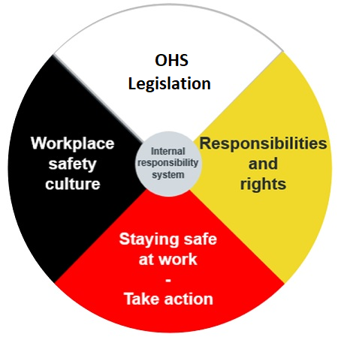
Learning outcomes

Slide 7
Part 1 – OHS legislation
Part 2 – Responsibilities and rights
Part 3 – Stay safe at work
Part 4 – Take action (reporting and notifications)
Part 5 – Workplace safety culture
Part 6 – Additional resources and evaluation
Agenda

Slide 8
Before we begin
Disclaimer
In the event of any discrepancy between the information throughout this presentation and Alberta OHS legislation, the legislation is considered correct.
© 2022, Government of Alberta, Alberta Labour and Immigration
This material is for information only. The information provided in this material is solely for the user’s information and convenience and, while thought to be accurate and functional, it is provided without warranty of any kind. The Crown, its agents, employees or contractors will not be liable to you for any damages, direct or indirect, arising out of your use of the information contained in this material.
Further, if there is any inconsistency or conflict between any of the information contained in this material and the applicable legislative requirement, the legislative requirement shall prevail. This material is current to July 2022. The law is constantly changing with new legislation, amendments to existing legislation, and decisions from the courts. It is important that you and keep yourself informed of the current law.

Slide 9
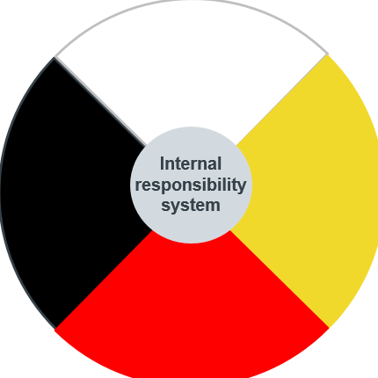

Slide 11
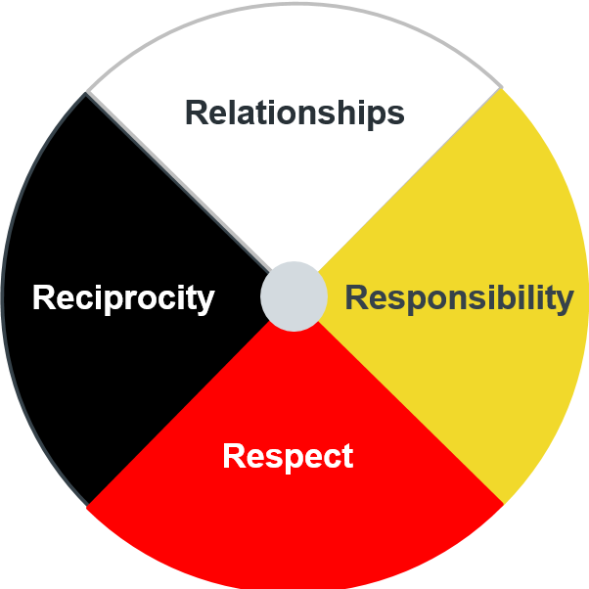
Miyo pimatisiwin in the workplace

Slide 13
OHS legislation
In Alberta, the OHS Act sets general rules to protect and promote the health and safety of workers.
The OHS Code specifies detailed technical standards and health and safety rules.
The legislation gives the government authority to enforce those rules.

Slide 14
OHS legislation continued
OHS legislation helps prevent workplace incidents, injuries and illnesses.
You should know that OHS law outlines:
your worker rights.
your responsibilities.
the responsibilities of your employer and others at the work site.

Slide 15
Does the OHS Act apply to me?
The OHS Act applies to most workers in Alberta.
The Canada Labour Code protects those working in a federally regulated workplace.

Slide 16
North American Occupational Safety and Health (NAOSH) week

Slide 17
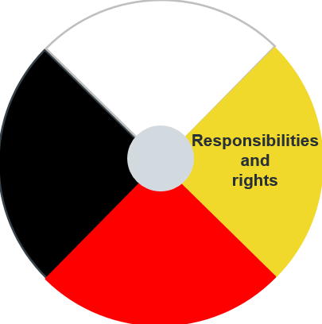

Slide 18
A safe and healthy workplace is everyone’s responsibility

Slide 19
Work site parties and responsibilities

Slide 20
Worker responsibilities include
Protecting yourself, coworkers and others at the work site.
Asking for training if you do not know how to do something.
Immediately reporting danger or unsafe working conditions to your supervisor or employer.
Correct usage and wear of personal protective equipment (PPE).
Not causing or participating in harassment or violence.
Cooperating with your employer by following health and safety rules for your job.
Telling your supervisor or employer if you have an issue that could affect your ability to work safely.
Only doing dangerous work if you are competent to do so, or are directly supervised by a worker who is.

Slide 21
Employer definition
An employer is someone who:
is self employed.
employs or engages one ore more workers.
is a designated employer representative.
oversees workers’ health and safety for a corporation or employer.

Slide 22
Supervisor definition
A supervisor is someone who:
has charge of a work site or authority over workers.

Slide 23
Supervisor responsibilities
Employer responsibilities
protects and tells you about the hazards of your job
ensures you are adequately trained to do your work safely
protects you from workplace harassment and violence
provides knowledgeable and qualified supervision
resolves health and safety concerns in a timely manner
makes sure you do your work safely and follow all health and safety rules
their workers aren’t subject to and don’t participate in violence or harassment
ensures you know the hazards of your work area
reports all health and safety concerns to the right people

Slide 24
Worker rights
You have the right to a safe, fair and healthy workplace.
As a worker, you have the right to:
know.
participate.
refuse unsafe work.
Under OHS laws, you cannot be disciplined for using your rights.

Slide 25
Worker rights (activity #1)
Using the three worker rights organize the cards under each category:
right to know.
right to participate.
right to refuse unsafe work.

Slide 26
10 minute break

Slide 27
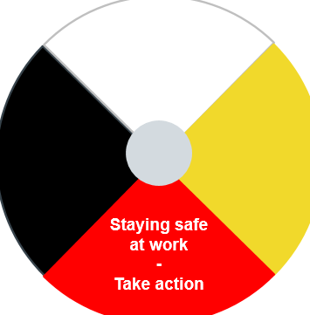

Slide 29
Safety tip: ask questions
What are my health and safety rights and responsibilities?
What are the specific hazards of my job?
Can you show me how to safely use this equipment?
Can you show me how to properly wear PPE?
What procedures do I follow if an emergency happens?

Slide 30
Safety tip: know the hazards
Hazards are:
a situation, condition or thing that may be dangerous to health and safety.
not always obvious; some can injure or make you ill right away, some may take time to realize effects.

Slide 31
Spot the hazard (activity #2)
Physical
Biological
Chemical
Psychosocial

Slide 32
Physical hazards

Slide 33
Biological hazards

Slide 34
Chemical hazards

Slide 35
Psychosocial hazards

Slide 36
Hazard controls
Most effective
✔
1st
choice
2nd
choice
3rd
choice
Engineering controls
Administrative controls
Elimination
PPE

Slide 37
Hazard assessments
Your employer must protect you from hazards through elimination or control.
Hazard assessments help to lower the risk of uncontrolled hazards in the workplace.

Slide 38
Safety tip: stop harassment and violence

Slide 39
Harassment and violence
Your employer has to address harassment or violence at the work site.
Do not cause or participate in bullying, gossiping or threatening behavior.

Slide 40
Lateral violence video and review
Notes:
youtube.com/watch?v=neWtt3sAqMM

Slide 41
10 minute break

Slide 43
Reporting incidents and injuries

Slide 44
Reporting to OHS
A prime contractor – or if there is no prime contractor, your employer – must report serious injuries, illness or incidents to OHS as soon as possible.
They must also report potentially serious incidents.

Slide 45
Reporting to WCB - Alberta
If you are injured at work, know you can report it to the Workers’ Compensation Board (WCB) - Alberta.
Report your injury to your employer and to your healthcare provider.
Go to wcb.ab.ca to find out more information on reporting.

Slide 46
Notify OHS of health and safety concerns
Anyone can report unsafe and unhealthy conditions at a workplace.
Call the OHS Contact Centre right away if you are concerned about immediate danger or injury from work, to you or anyone else.

Slide 47
1-866-415-8690

Slide 48
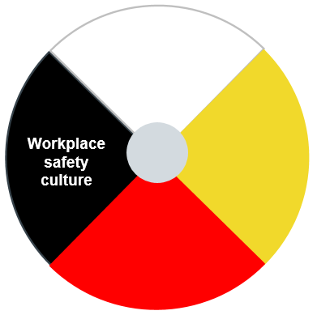

Slide 49
Understanding the workplace
Safety culture is displayed through actions, attitudes and values within the workplace.
Your employer should strive to promote and create a positive safety culture in your workplace.
Workplaces will have their own individual safety culture that is important for you to learn, follow and show.

Slide 50
Involvement within safety culture
Know what the general safety rules are in your workplace.
read written policies and procedures
follow adopted, or unwritten rules, that your co-workers display and ask questions
Make sure you follow and show respect for rules that outline expectations of workplace etiquette.

Slide 51
Meeting employer expectations
Within workplace safety culture, employers rules may be written, while others are expected.
When you start a job contribute by:
meeting your employers job expectations.
showing commitment within the workplace.

Slide 52
Teamwork

Slide 53
Effective communication
Listen to others with purpose.
Respect supervisor instructions and repeat them back to the supervisor.
Explain safety concerns to your supervisor.
Handle concerns calmly and respectfully.
Notes:
.

Slide 54
Communication within a diverse workplace

Slide 55
Miyo pimatisiwin creating healthy workers and workplaces (activity #3)
Spiritual
Emotional
Mental
Physical

Slide 56
Additional resources

Slide 57
OHS education and resources
alberta.ca/ohs

Slide 60
Provincial contacts
OHS Contact Centre
1-866-415-8690 (toll free)
WCB – Alberta
wcb.ab.ca
Employment Standards Contact Centre
1-877-427-3731 (toll free)
Alberta Human Rights Commission
albertahumanrights.ab.ca

Slide 61
Review

Slide 62
Key points
Participate in workplace health and safety and fulfill your responsibilities.
You have rights as a worker and can’t be punished for using them.
Follow and use your safety tips.
Report injuries and incidents.
Contribute to a healthy workplace safety culture.

Slide 63
Miyo pimatisiwin in the workplace

Slide 64
Questions?

Slide 65
Evaluation

Slide 66
Thank you
Miikwecc (Saulteaux)
Ay-hay (Cree)
Marsee (Michif)
Nitsiniiyi’taki (Blackfoot)
Isniyés (Nakota)
Masi chok (Dene)
March 2022 | IWR003B

